Slide 1
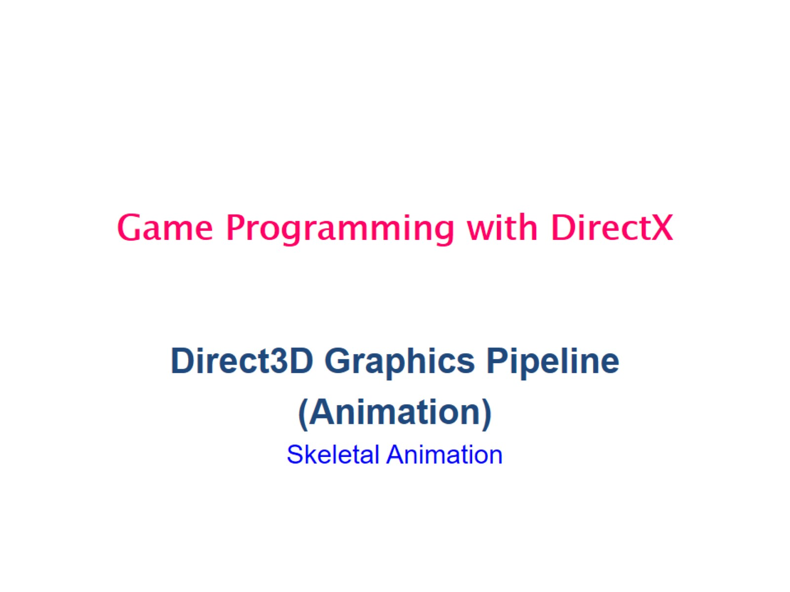
Game Programming with DirectX

Slide 2
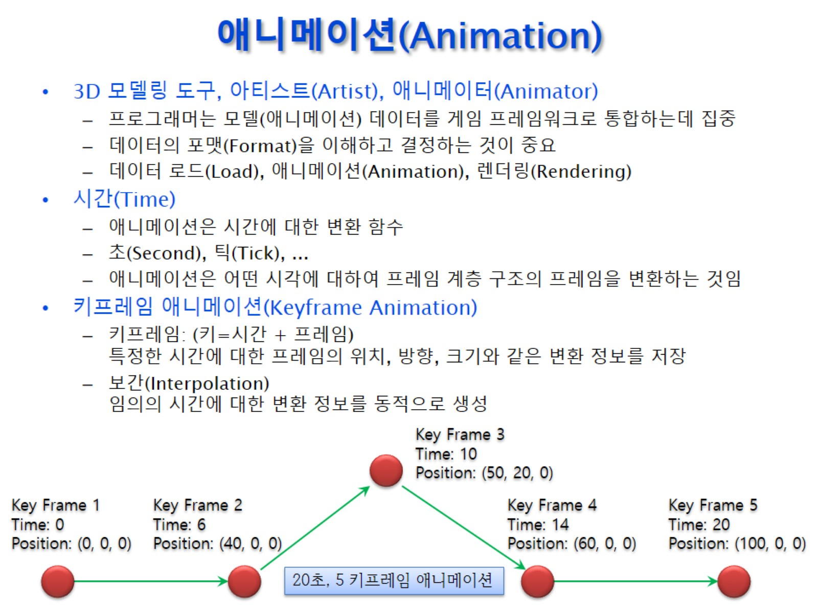
애니메이션(Animation)

Slide 3
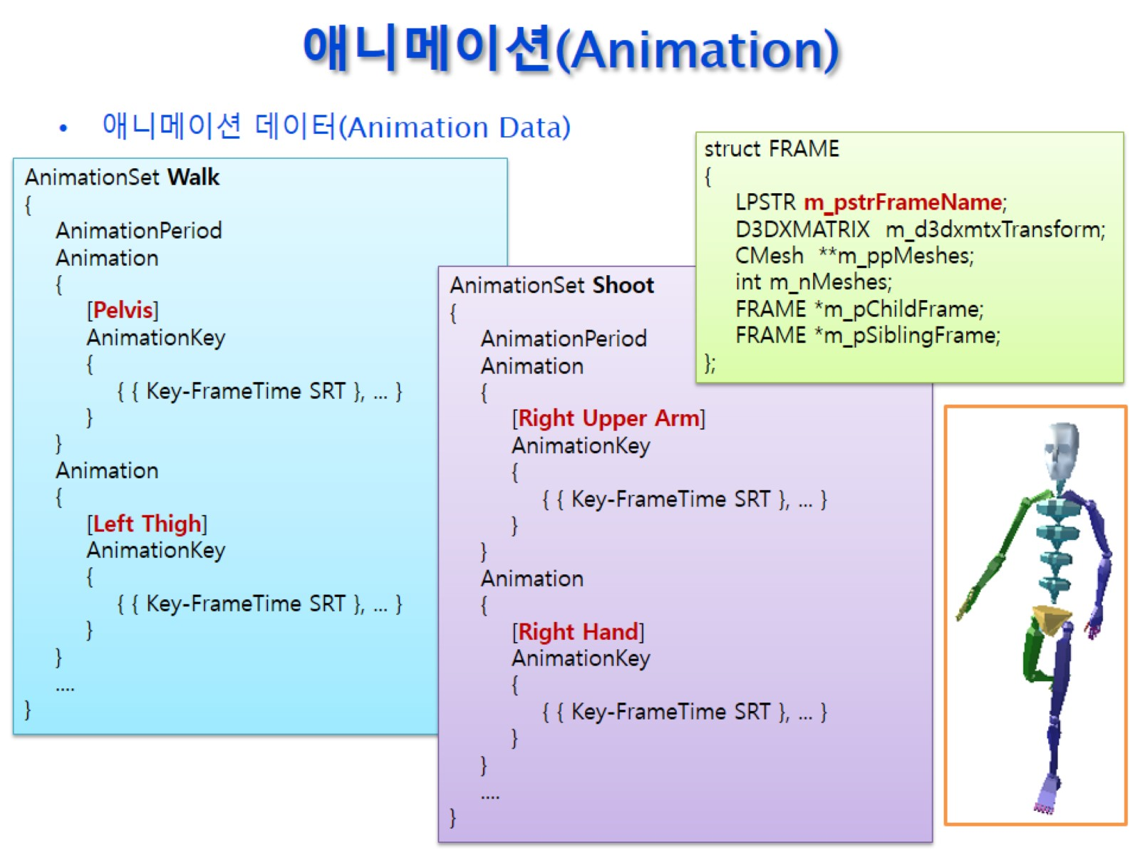
애니메이션(Animation)

Slide 4
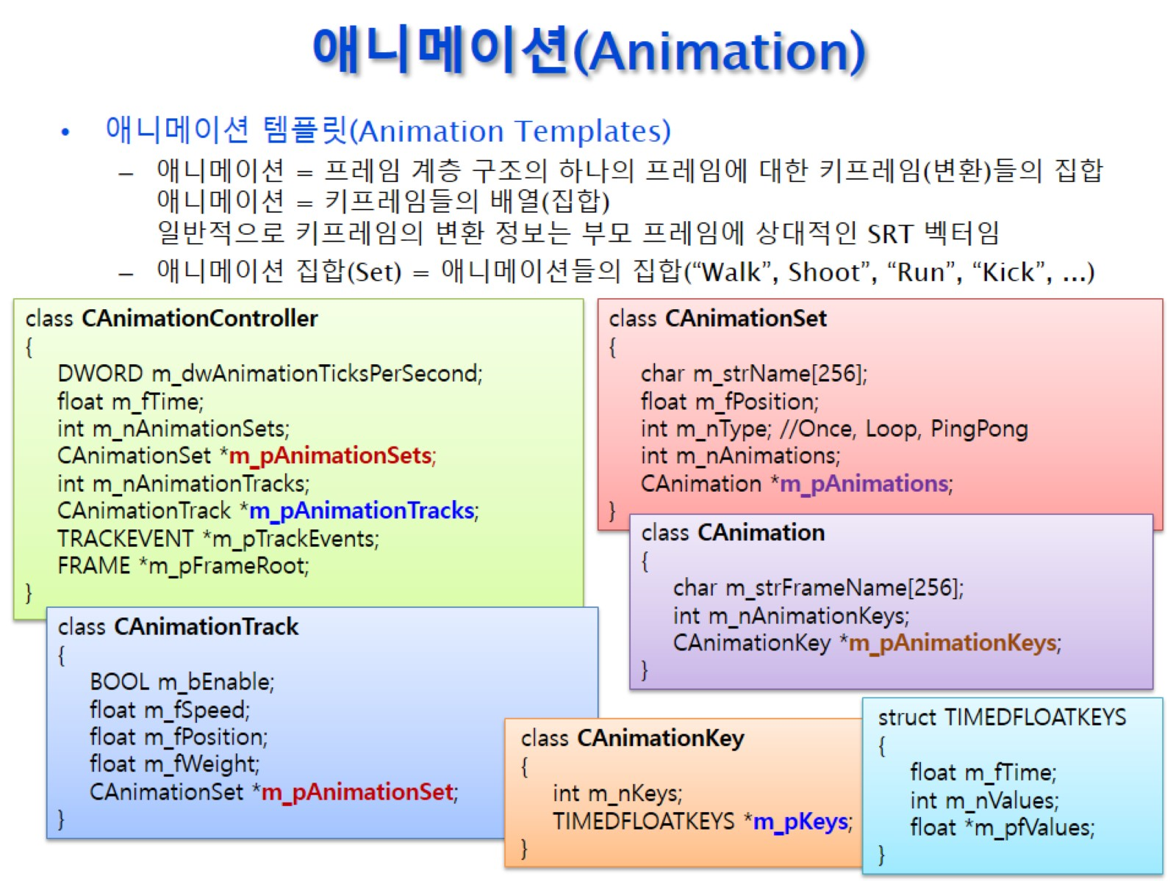
애니메이션(Animation)

Slide 5
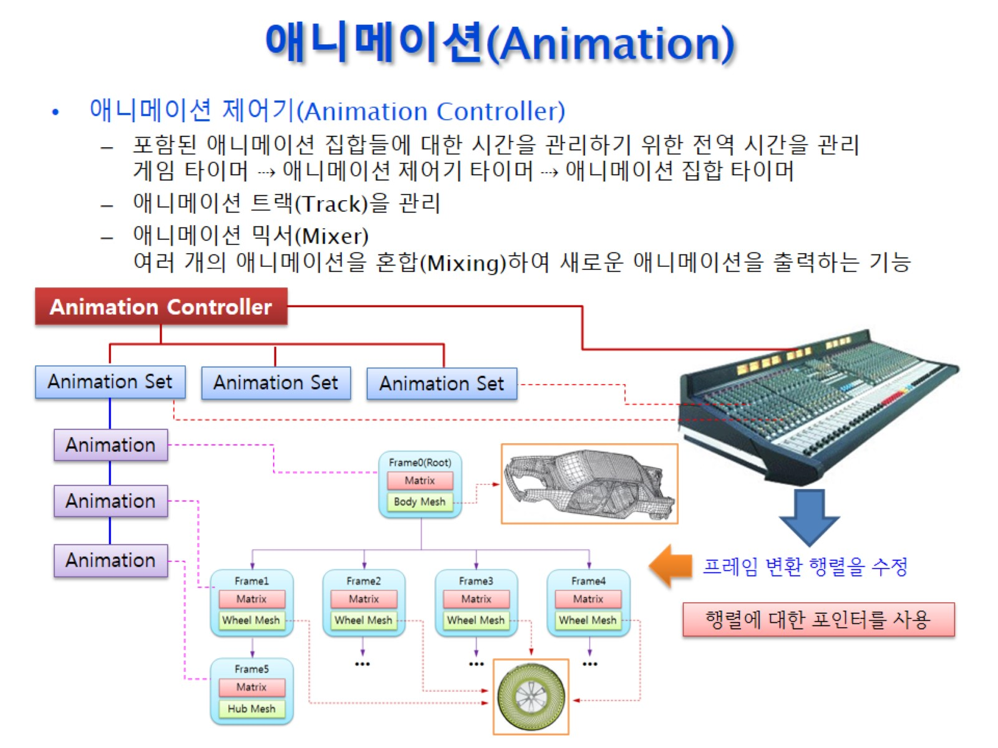
애니메이션(Animation)

Slide 6
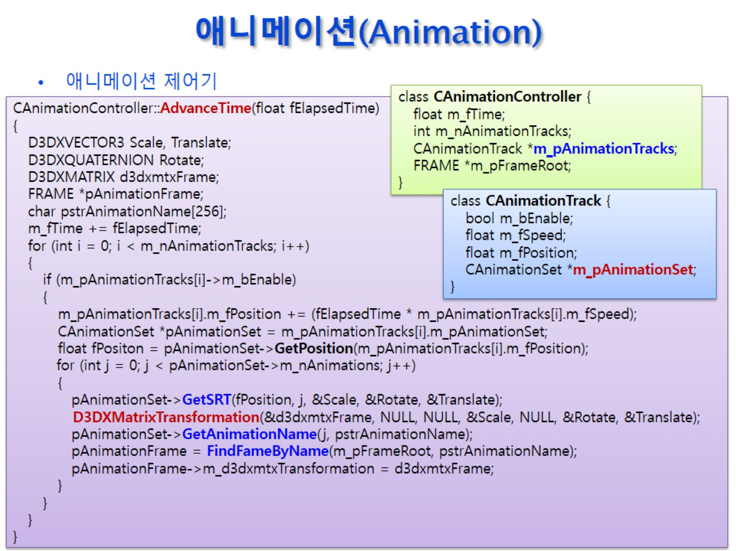
애니메이션(Animation)

Slide 7
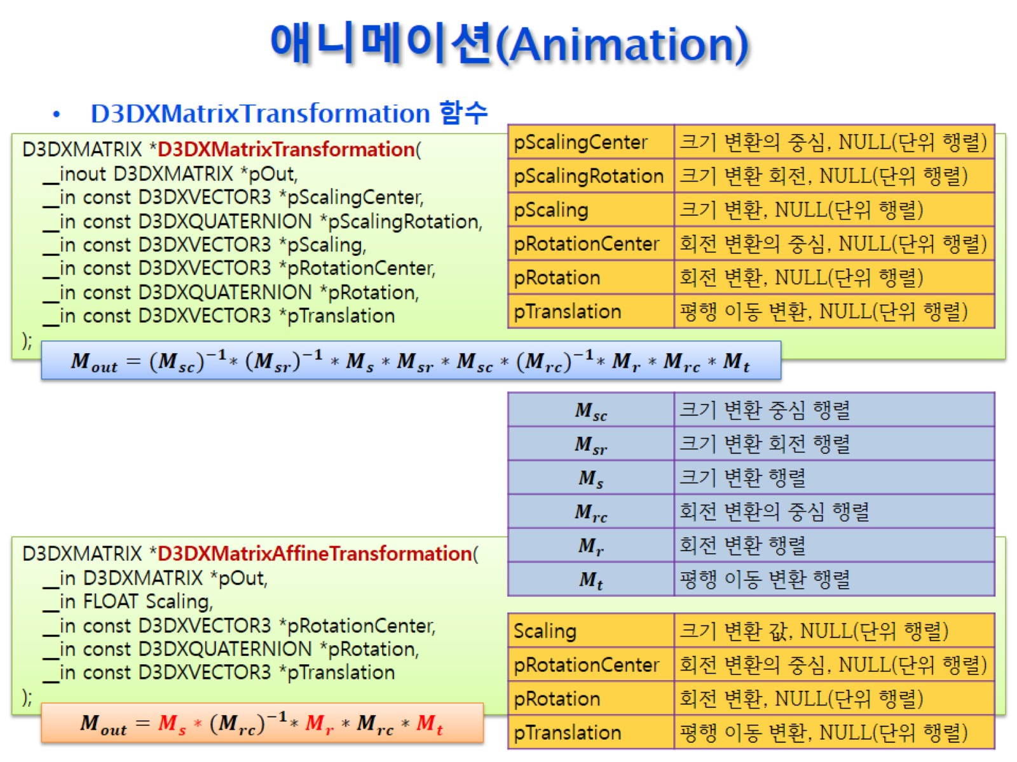
애니메이션(Animation)

Slide 8
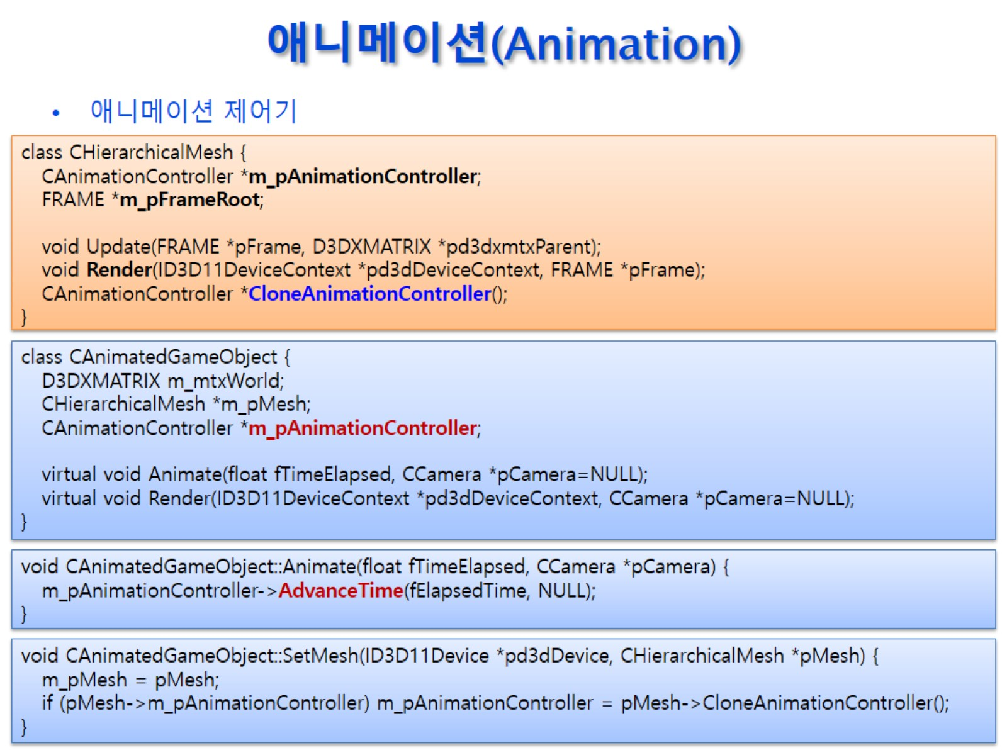
애니메이션(Animation)

Slide 9
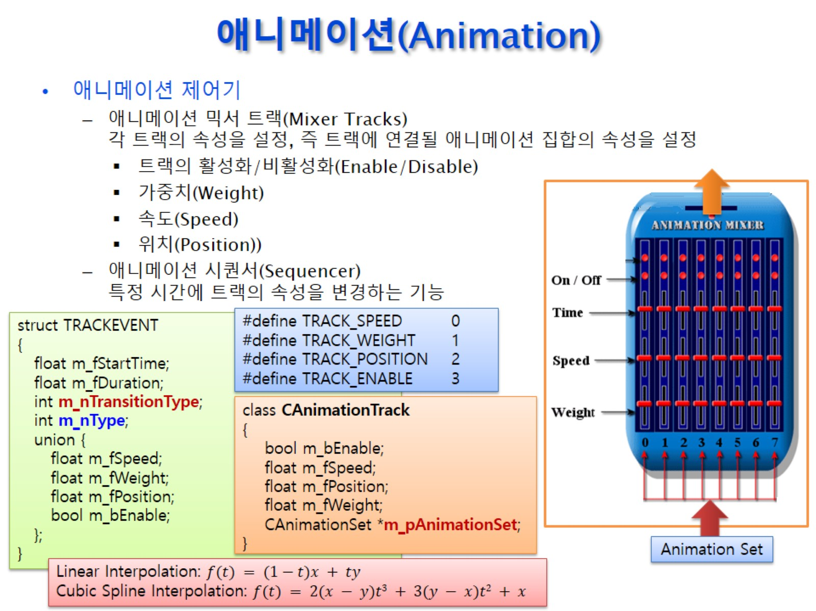
애니메이션(Animation)

Slide 10
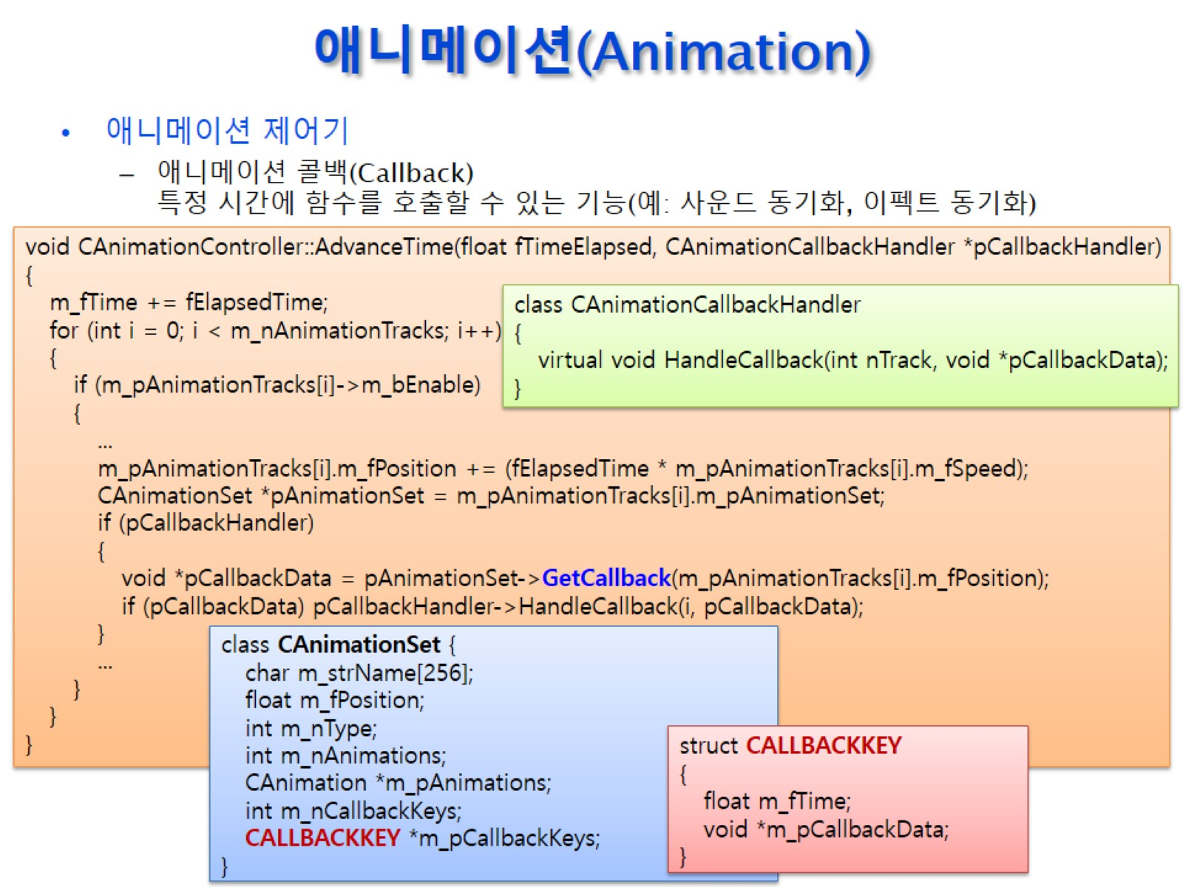
애니메이션(Animation)

Slide 11
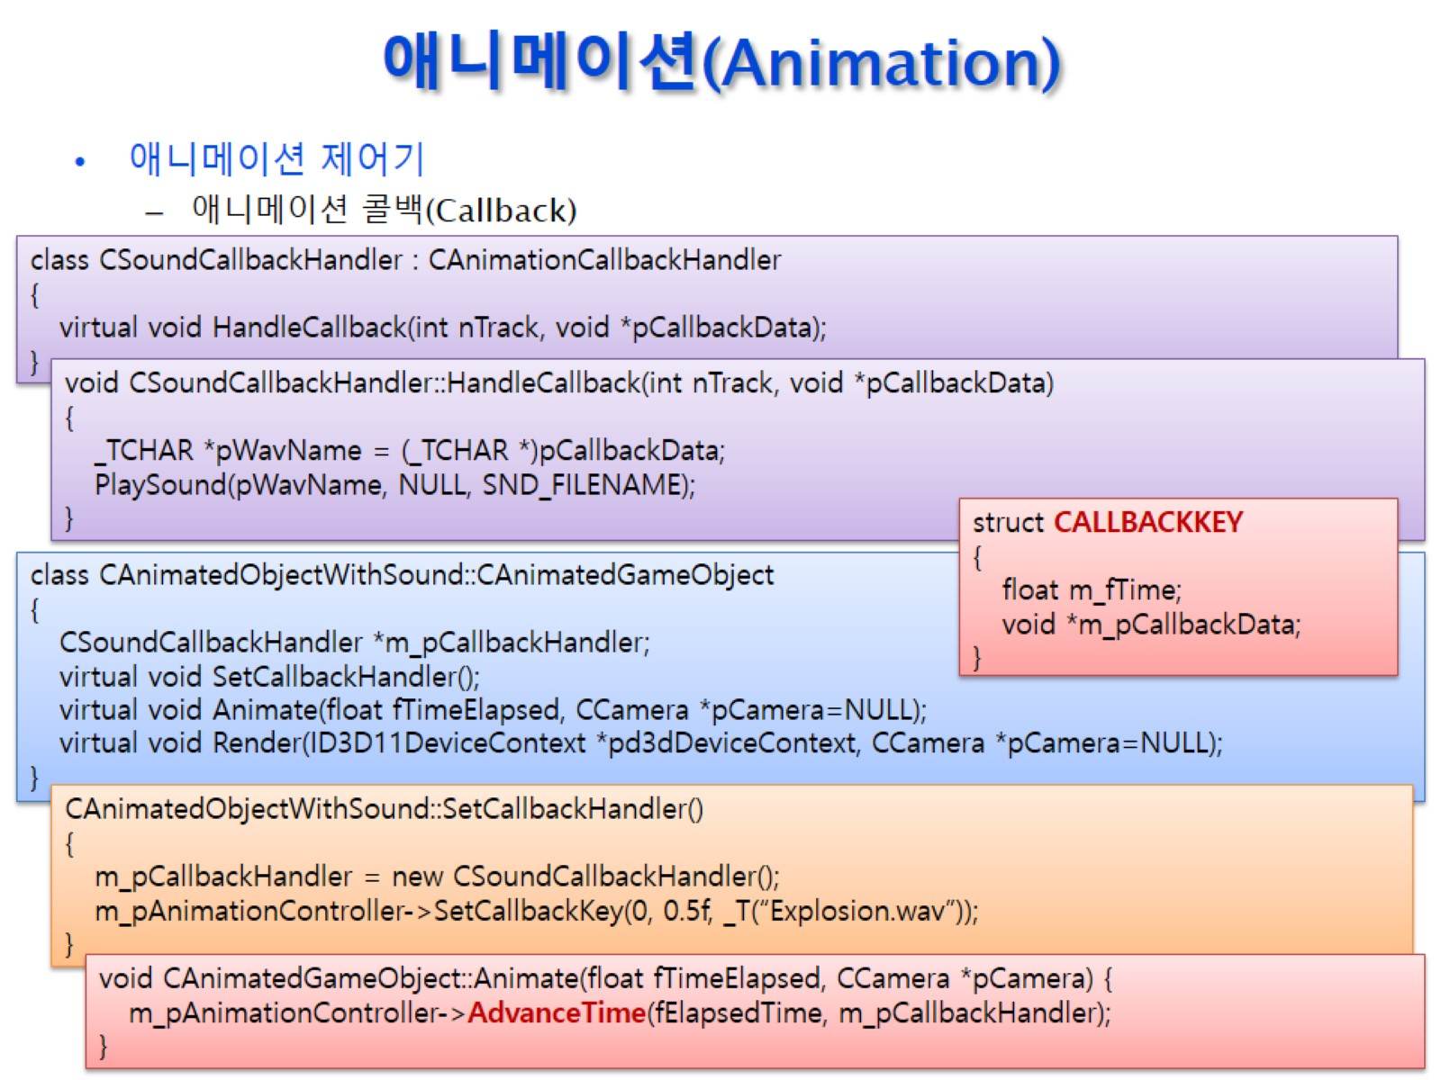
애니메이션(Animation)

Slide 12
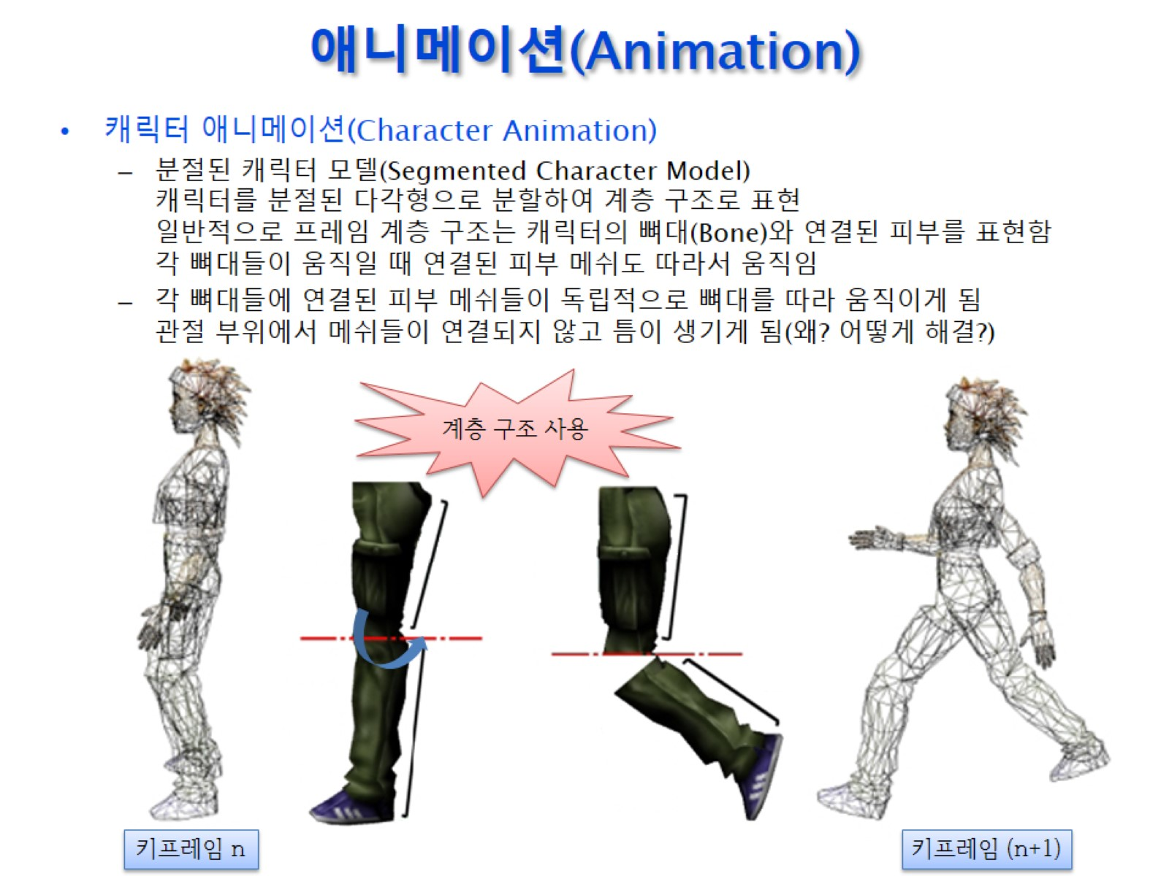
애니메이션(Animation)

Slide 13
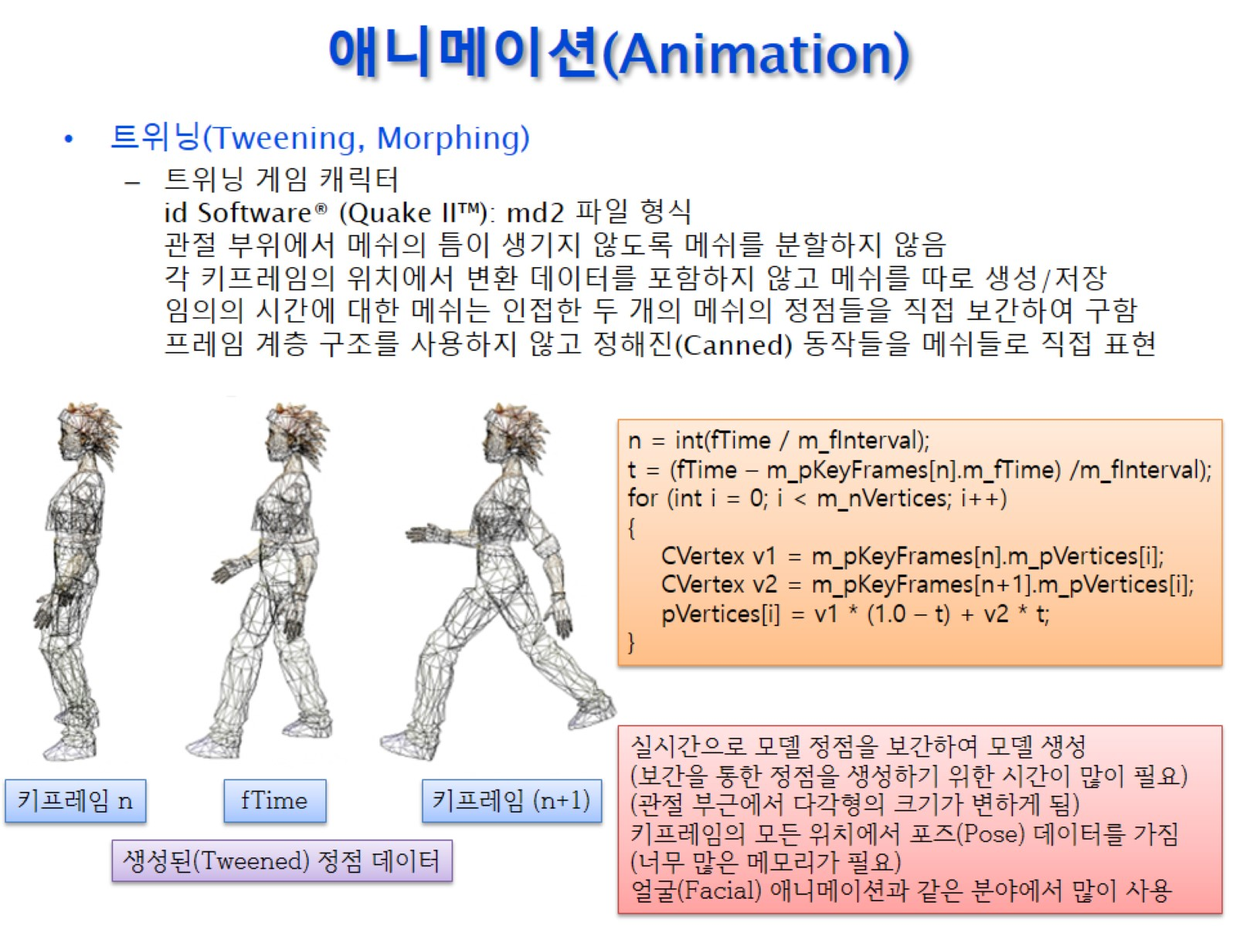
애니메이션(Animation)

Slide 14
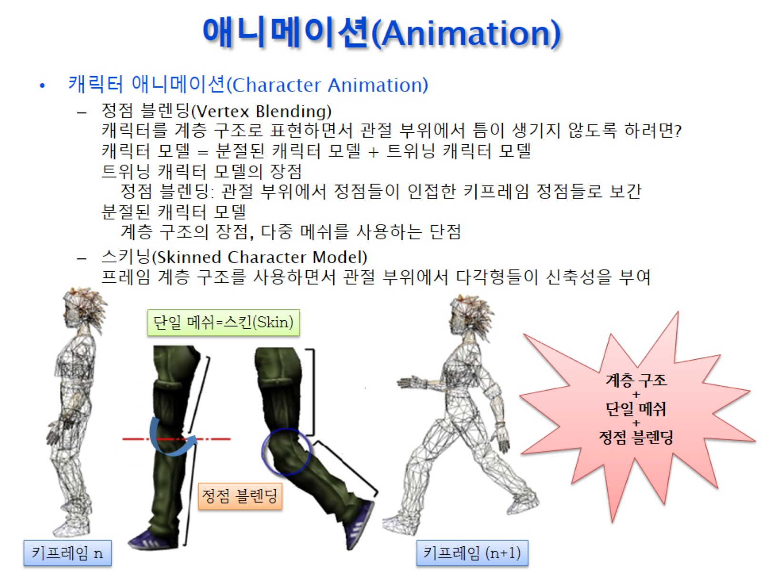
애니메이션(Animation)

Slide 15
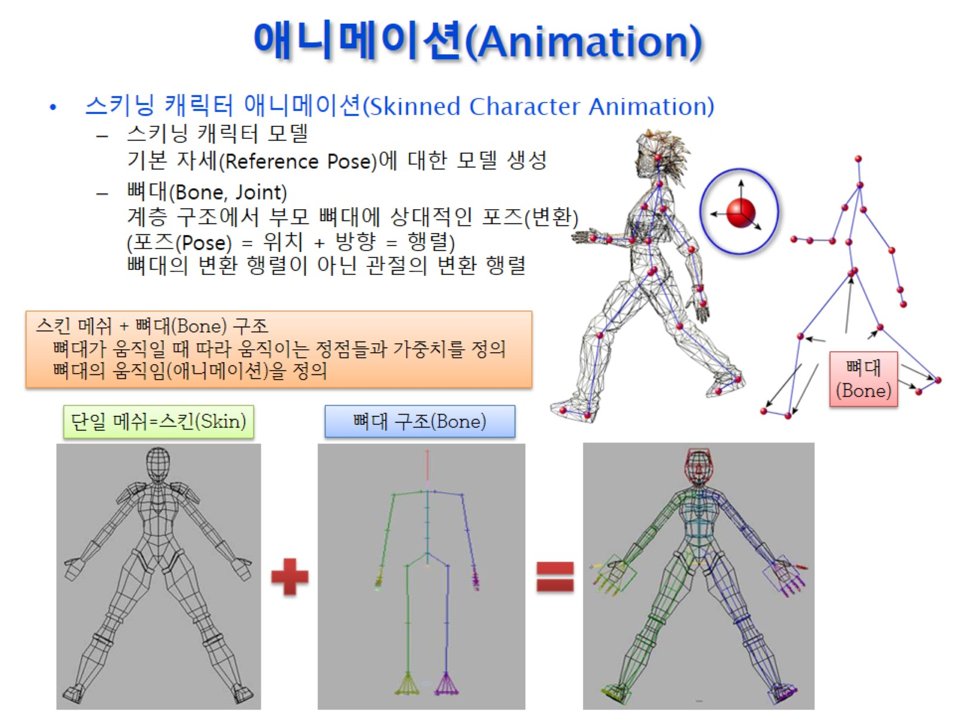
애니메이션(Animation)

Slide 16
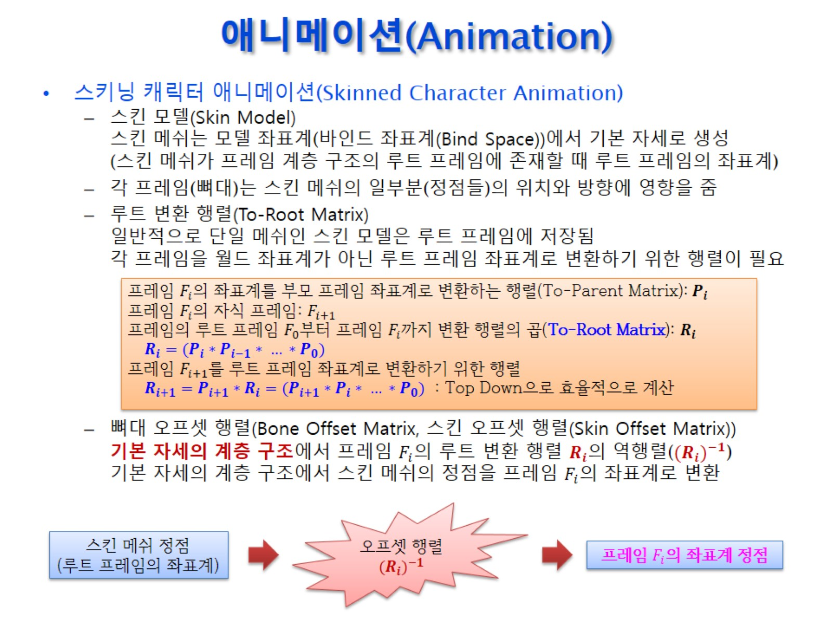
애니메이션(Animation)

Slide 17
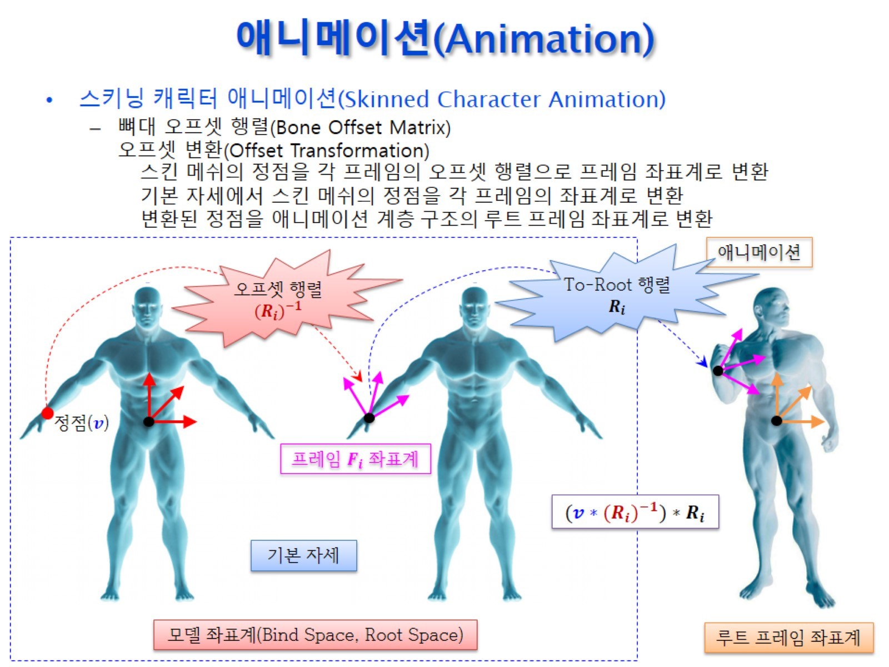
애니메이션(Animation)

Slide 18
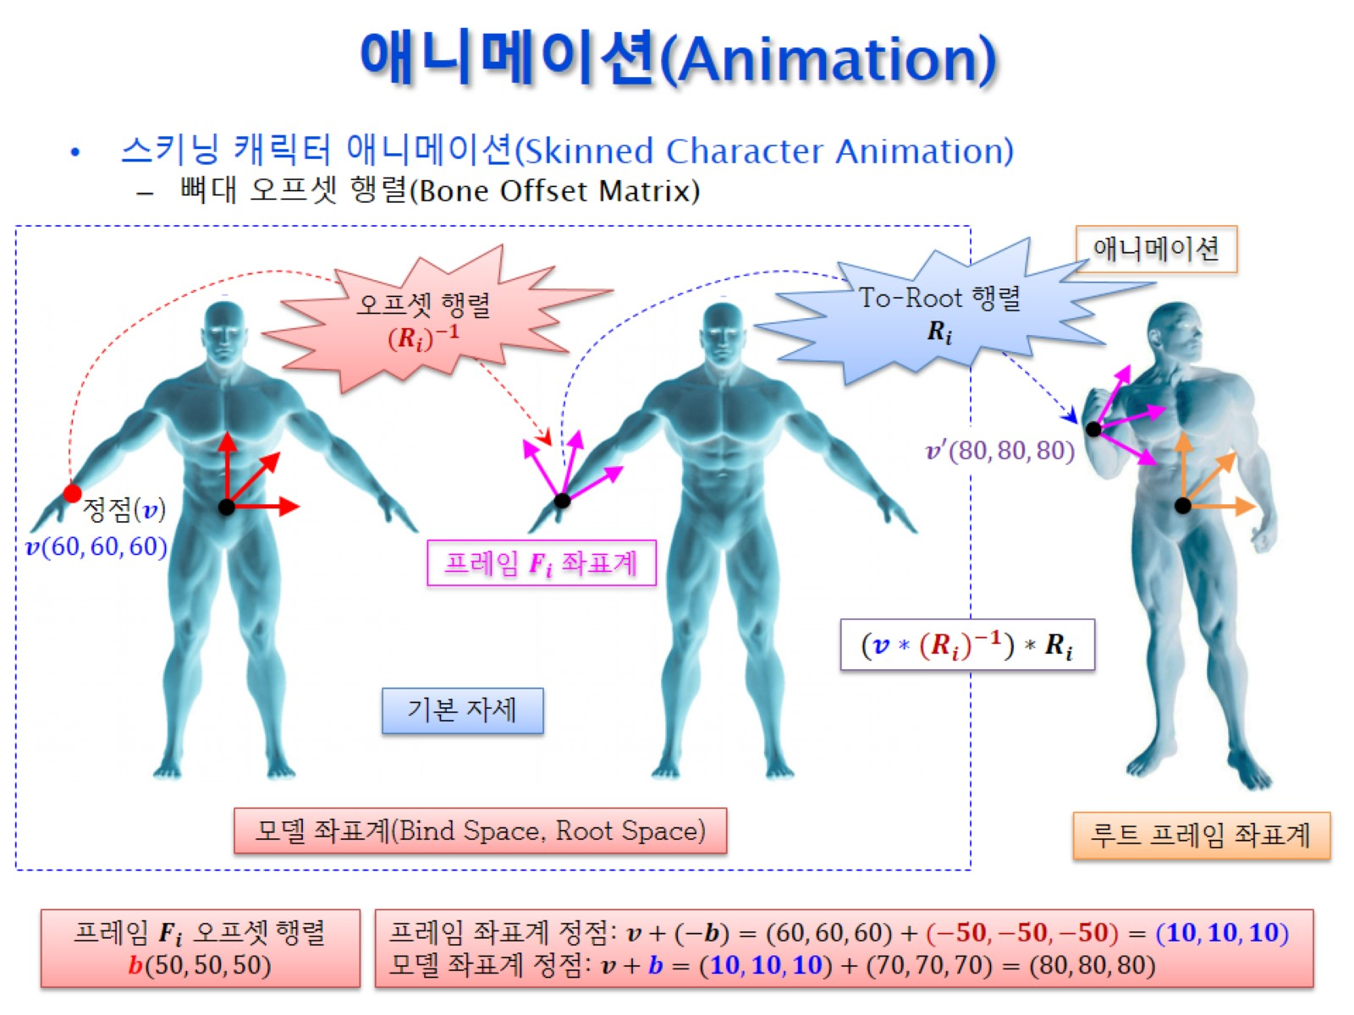
애니메이션(Animation)

Slide 19
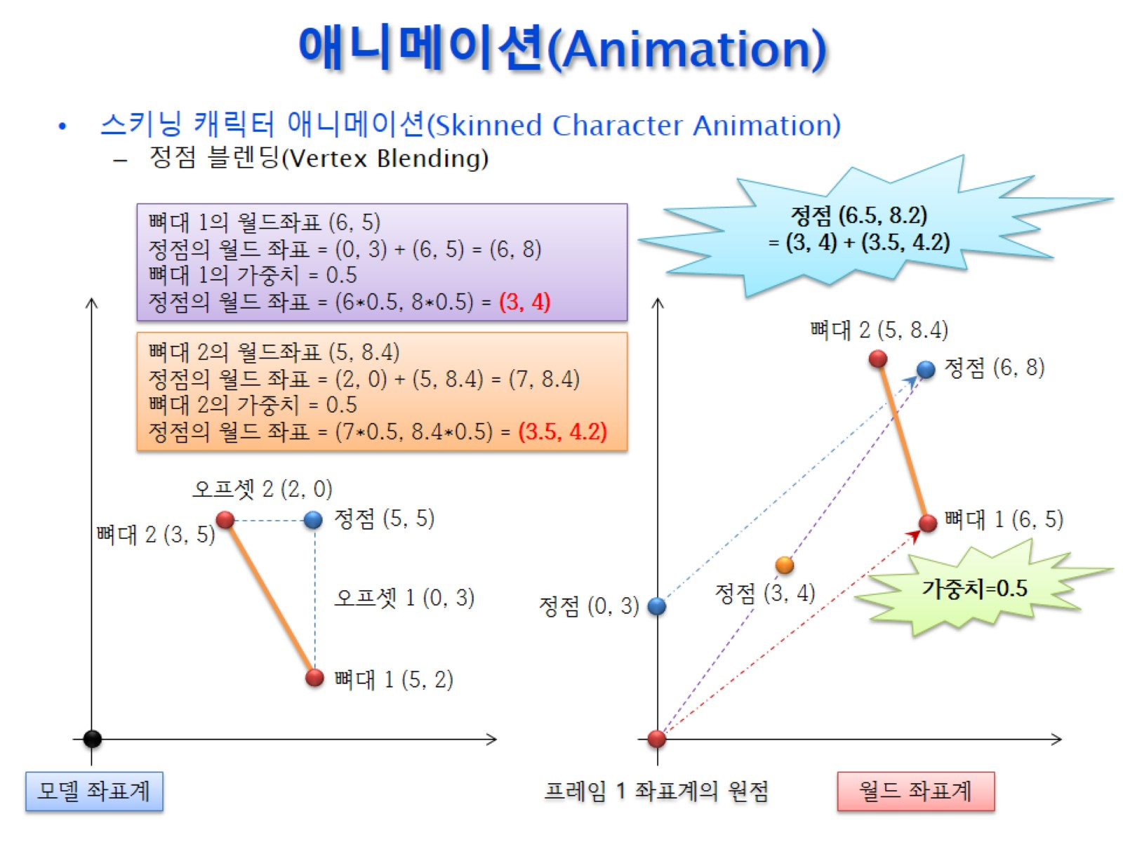
애니메이션(Animation)

Slide 20
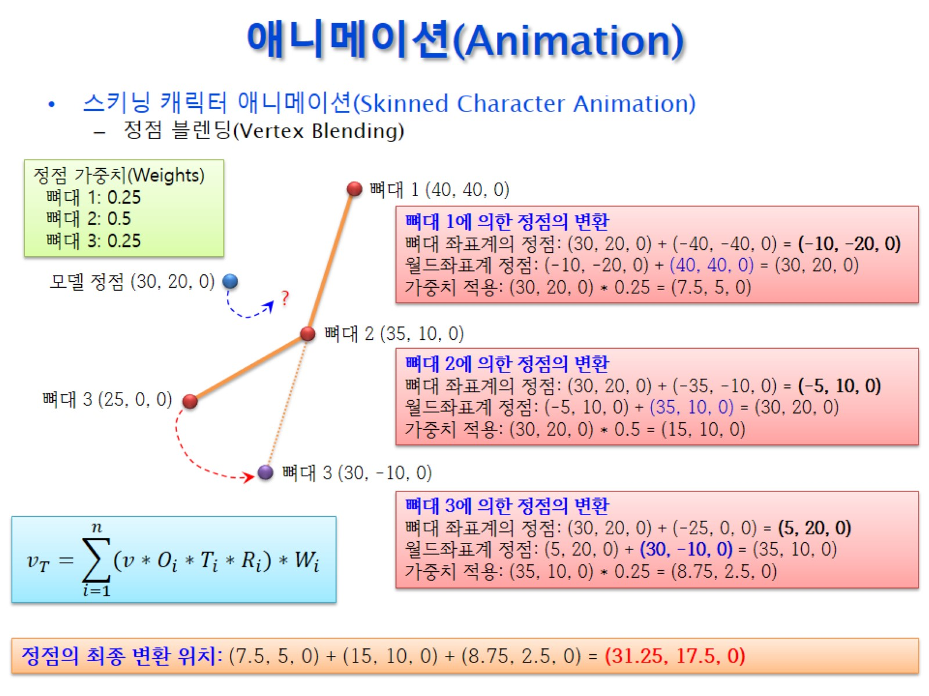
애니메이션(Animation)

Slide 21
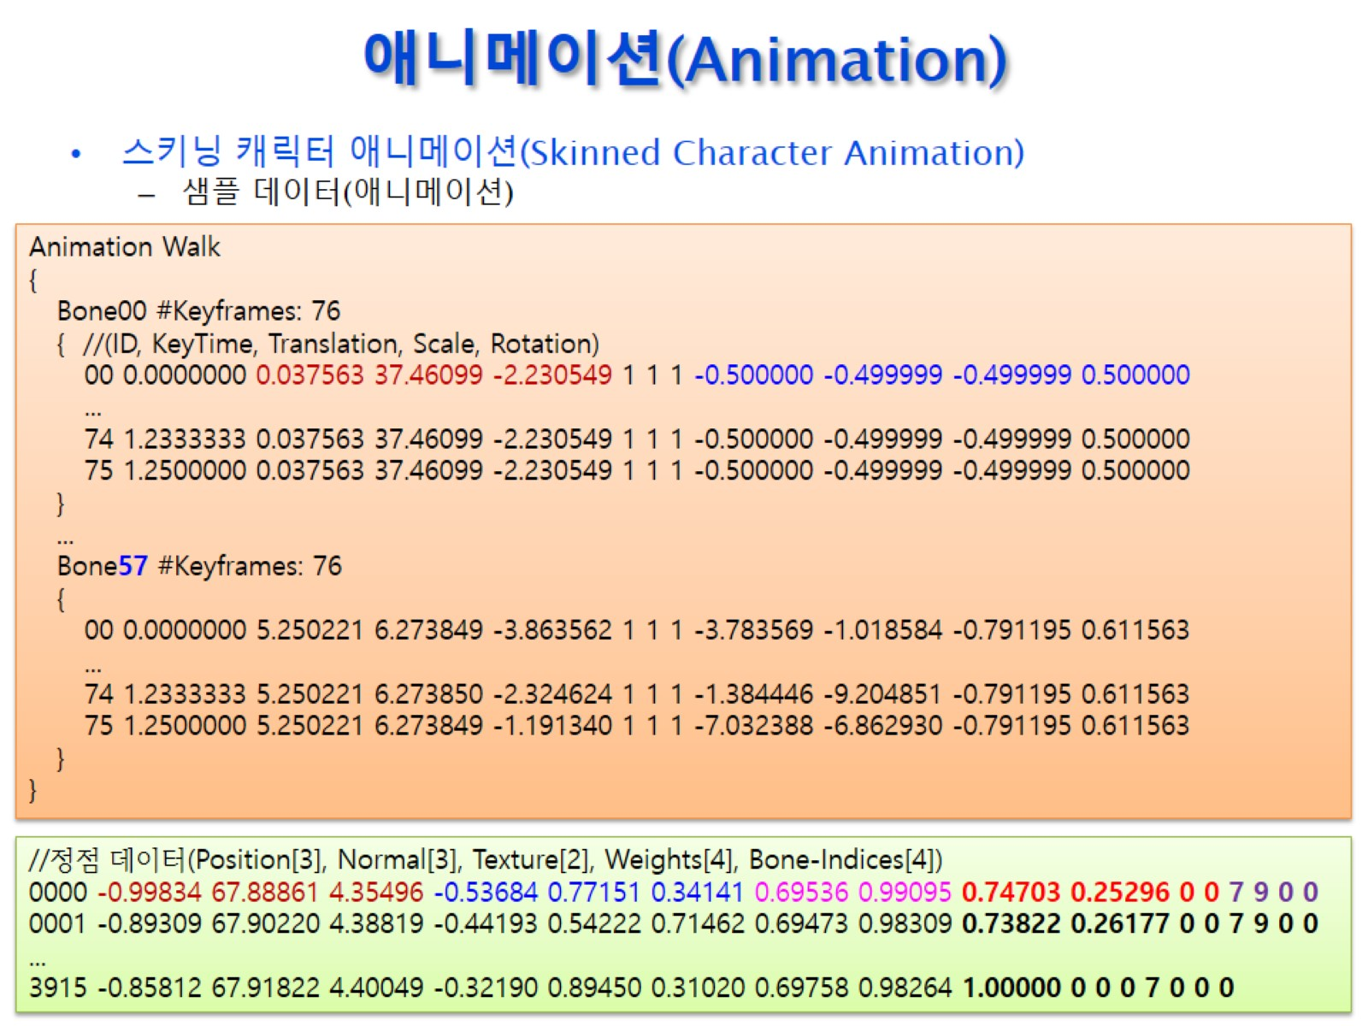
애니메이션(Animation)

Slide 22
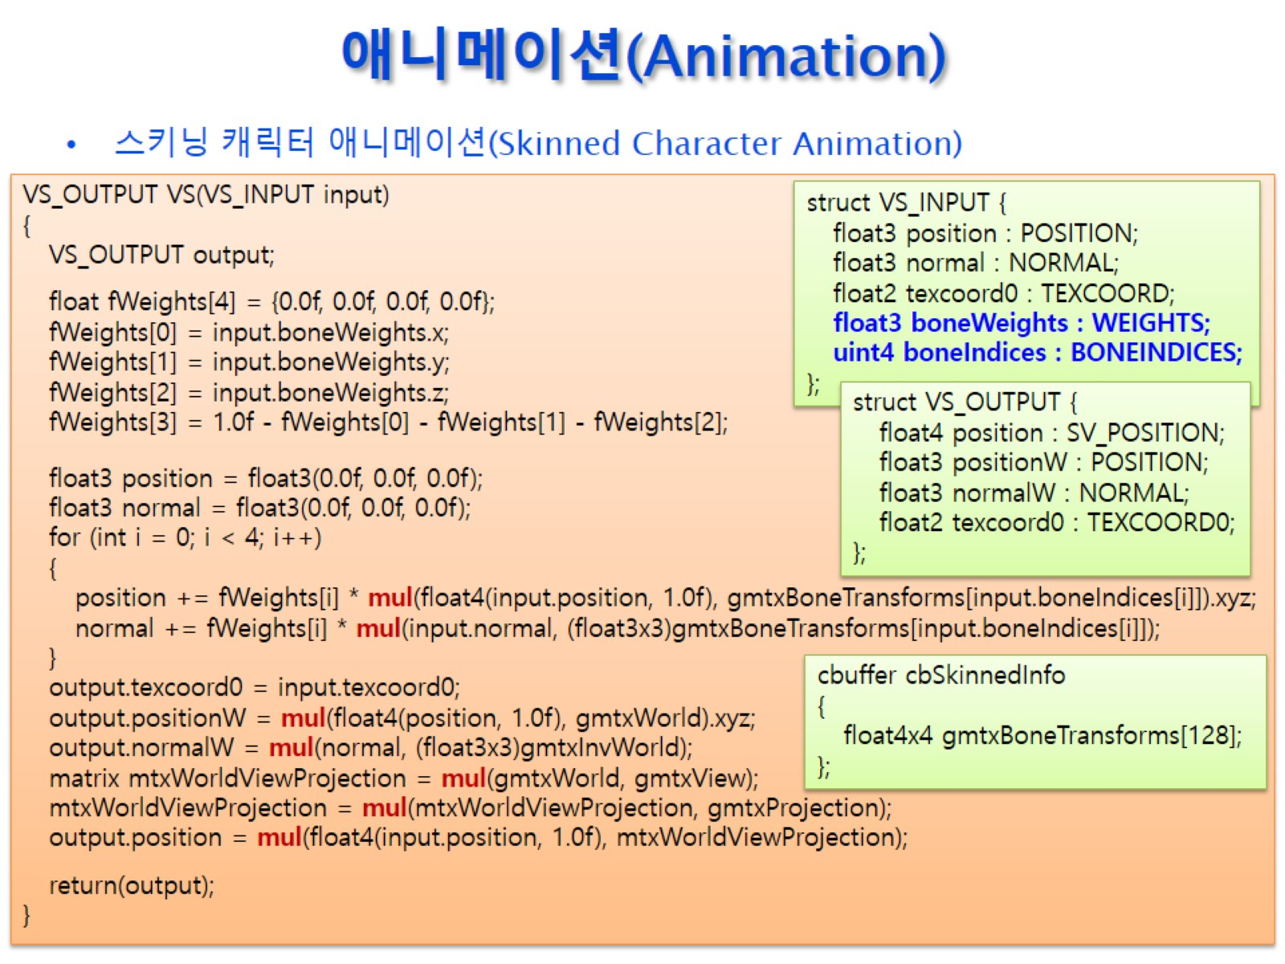
애니메이션(Animation)

